Slide 1


2.1 MNNs with explicit input patterns
The input pattern has a known dimension and it is considered as the main input of the network. (Quantized map)
Simple Feed-Forward MNN
One layer Hetro-Associative and Auto-Associative Networks
Heb Learning method for simple Non-Iterative MNN
Simple Recurrent MNNs
Auto-Associator With Threshold Function (Iterative Hetro-Associative Network)
Hopfield Network (Iterative Associative Network)
Bidirectional MNNs (Iterative Hetro-Associative Network)
MNNs by using Classifiers: MLP, DBNNs and CNNs

Slide 2
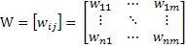

One layer Feed-Forward Network for pattern association
x₁
y₁
Input pattern:
Output pattern:
Weight Matrix
x_{i}
y_{j}
Activation Function: Sign Function
Output Patterns: Bipolar/Binary
x_{n}
y_{m}
Auto-Associative Memory : the output patterns and the input patterns are the same in the learning phase. However, in the real cases, the input pattern is deformed or disturbed with noise.
Hetro-Associative Memory : the output patterns and the input patterns are not the same in learning phase but in real cases the input patterns are deformed or disturbed
Aim: the weight matrix W is learned in order that for each pair of input-output Patterns: (s(p),t(p)), (p=1..P), y =f(s(p)^{T}W)→t(p)

Slide 3
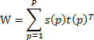
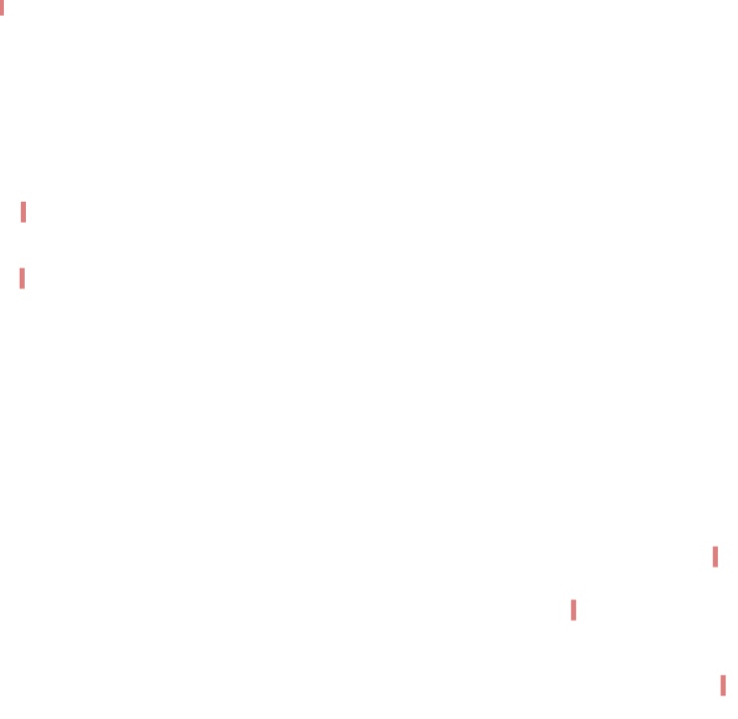
Pattern Association Algorithm by Hebbian Learning Rule
Step1: Initialize the weight matrix: w_{ij}=0 (i=1..n, j=1…m)
Step2: For each input-output pair ({s(p),t(p)}, p=1,2,….,P) do following steps: s^{T}=[s₁ …s_{i}…s_{n}] t^{T}=[t₁….t_{j}….t_{m}]
Step3: For i=1…n s_{i} →x_{i}
Step4: For j=1…m t_{j} →y_{j}
Step5: w_{ij}⁺ :=w_{ij}⁻+x_{i}y_{j}
_{End}
*It can be shown that the weight matrix is sum of the outer-products of input –output patterns:

Slide 4
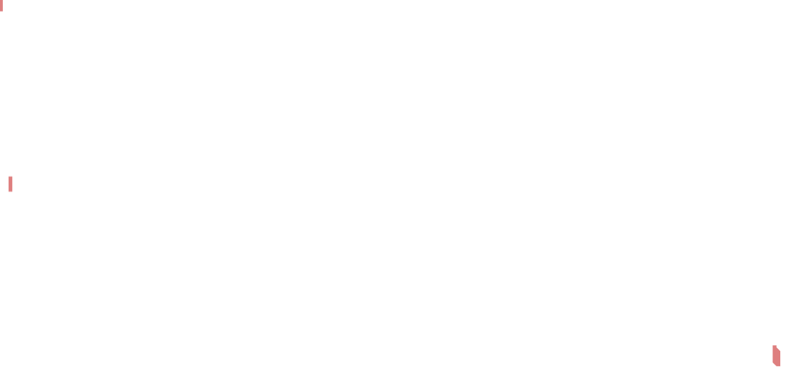
Sufficient Conditions for Pattern Association by Hebbian learning rule
If all input patterns are orthogonal together then their target patterns will be associated by the network :
If (1) each pair of input patterns, which have different target patterns, are orthogonal together and (2) inner product of each pair of input patterns, which have the same target patterns, is positive, then their target patterns will be associated by the network :

Slide 5
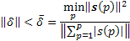
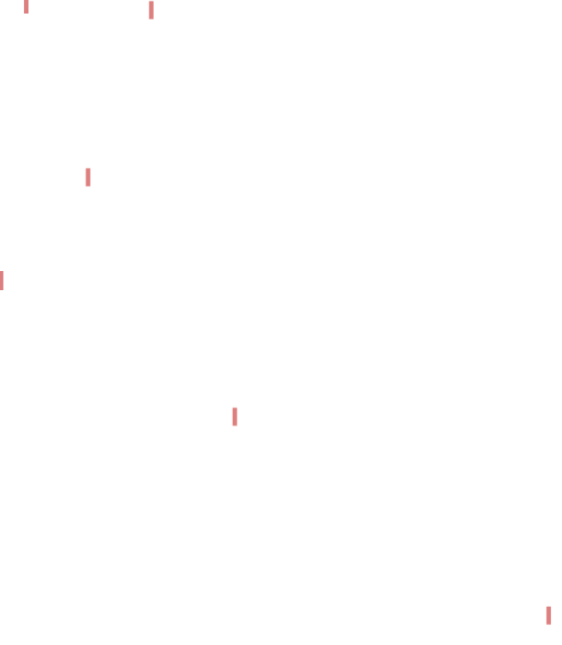
Input Pattern with disturbance
If the input pattern s(p) is added by a disturbance
Then the output pattern is computed as follows:
where
To associate true output patter it is enough:
A sufficient condition for output-disturbance can be computed as follows:
A sufficient condition for input-disturbance can be computed as follows :
As a result:

Slide 6
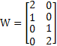
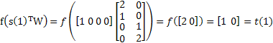
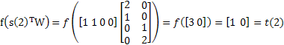
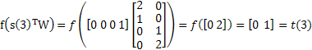
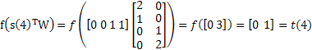
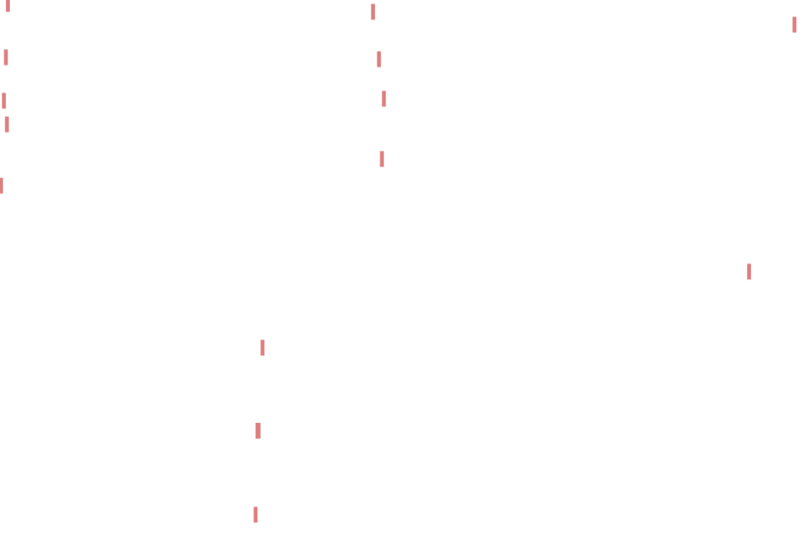
Example(1)
P=4
S(1)^{T}=[1 0 0 0]→t(1)^{T}=[1 0]
S(2)^{T}=[1 1 0 0]→t(2)^{T}=[1 0]
S(3)^{T}=[0 0 0 1]→t(3)^{T}=[0 1]
S(4)^{T}=[0 0 1 1]→t(4)^{T}=[0 1]
S(p)
t(p)
m=2
W=s(1) t(1)^{T}+s(2) t(2)^{T}+s(3) t(3)^{T}+s(4) t(4)^{T}
n=4

Slide 7
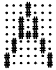
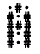
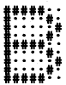
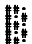
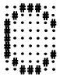
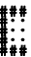
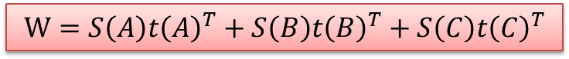

Example(2) character Recognition
n=63
m=15
S(A)^{T}=[-1 -1 -1 1 -1….-1-1 1]_{63*1}
t(A)^{T}=[-1 1 -1 ….1-1 1]_{15*1}
S(B)
t(B)
S(C)
t(C)
$$W=S\left(A\right)t{\left(A\right)}^{T}+S\left(B\right)t{\left(B\right)}^{T}+S\left(C\right)t{\left(C\right)}^{T}$$
It works for three characters

Slide 8
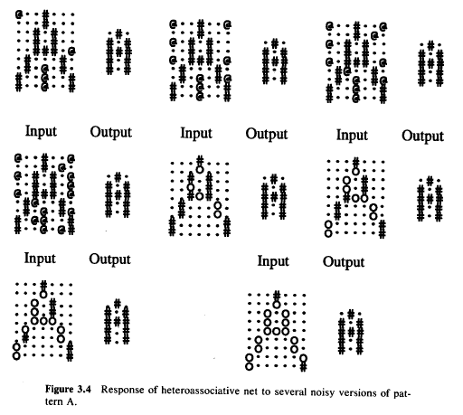
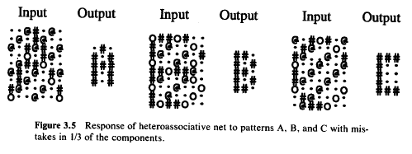
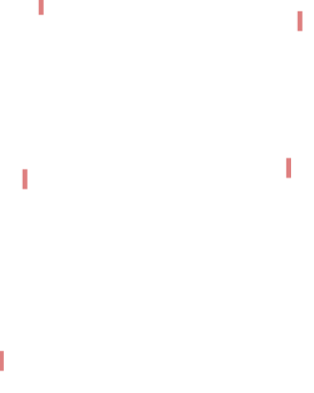
Network Evaluation with disturbed input patterns

